Slide 1
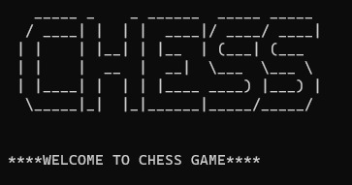
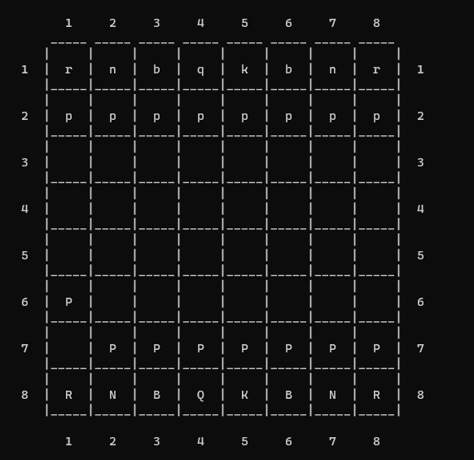
CHESS GAME
PRESENTED BY:
SARA TARIQ 02-235221-032

Slide 2
TABLE OF CONTENTS:
ABSTRACT.
INTRODUCTION.
SCOPE OF PROJECT.
METHODOLOGY.
TOOLS/TECHNOLOGY.
FLOWCHART.
OUTPUT.
CONCLUSION.
REFERENCE.

Slide 3
ABSTRACT:
This project implements a chess game using data structures and algorithms in C++. The game is played on a 8x8 board and features all of the classic rules of chess, including castling, en passant, and checkmate. The game is implemented using a variety of data structures, including vectors, maps, and linked lists. The algorithms used in the game include a recursive search algorithm for finding legal moves, a minimax algorithm for evaluating board positions, and a backtracking algorithm for finding checkmates. The game is implemented in a modular fashion, making it easy to extend and modify. The game is also fully documented, making it easy to understand and learn.

Slide 4
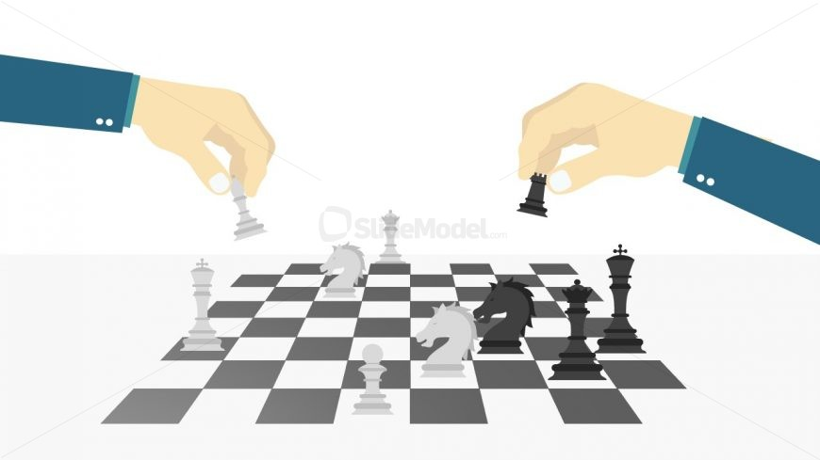
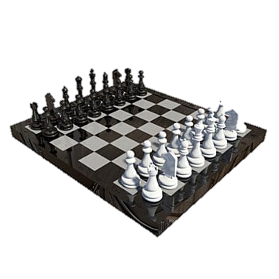
INTRODUCTION:
This report describes the development of a fully functional chess game implemented in C++. The game adheres to the classic rules of chess and includes features such as castling, en passant, and checkmate. It utilizes various data structures like vectors, maps, and linked lists. The game employs recursive search, minimax, and backtracking algorithms for move generation, evaluating board positions, and finding checkmates respectively. The project was divided into three phases: basic mechanics implementation, feature enhancement, and final polish and testing. The final product is a user-friendly chess game that offers both entertainment and challenge. It can be played against a computer or another human player and can be easily extended or modified. The project provided valuable learning experiences in chess game design, data structures, algorithms, and programming skills such as OOP, modular programming, and testing.

Slide 5
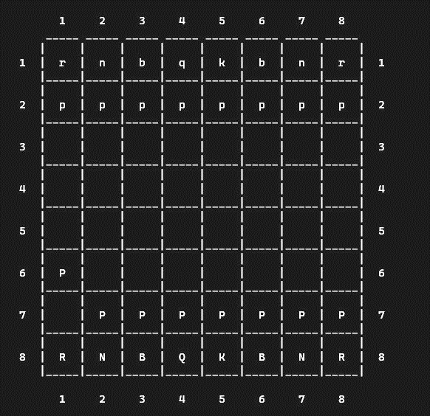
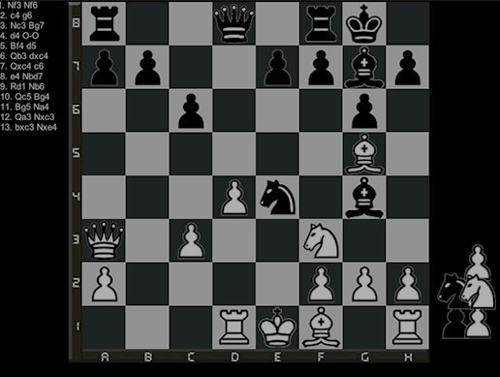
SCOPE OF PROJECT:
The scope of the Chess Game project in Data Structures and Algorithms (DSA) using C++ encompasses the implementation of a fully functional chess game that allows human players to play against an AI opponent. The project involves designing and implementing the necessary data structures, algorithms, and game mechanics to facilitate move validation, game state management, and player input. The AI component utilizes DSA concepts and algorithms to evaluate and select optimal moves based on the current game state. The project aims to provide an interactive and enjoyable chess playing experience while demonstrating proficiency in applying DSA principles and techniques in a practical context using the C++ programming language.

Slide 6
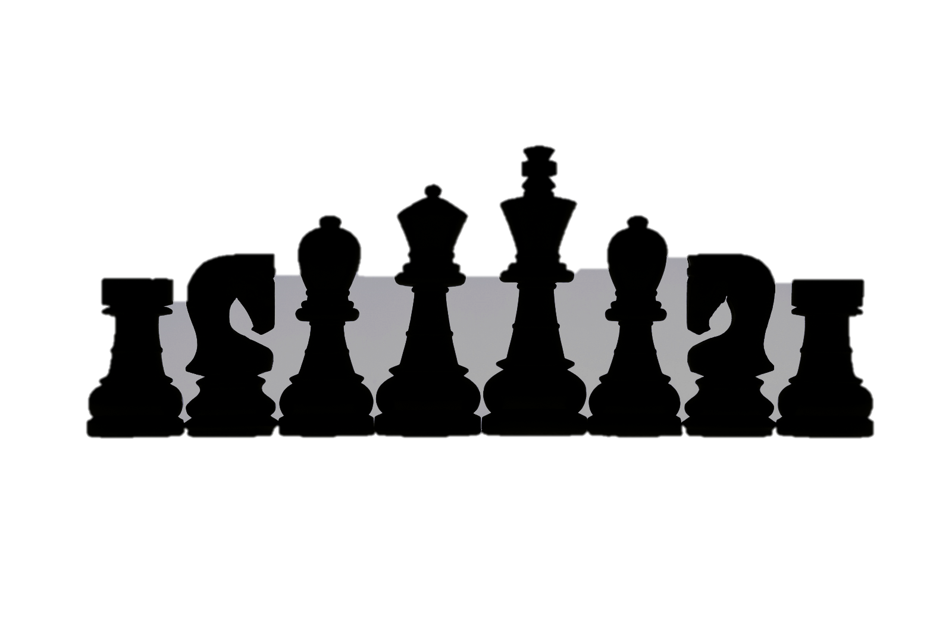
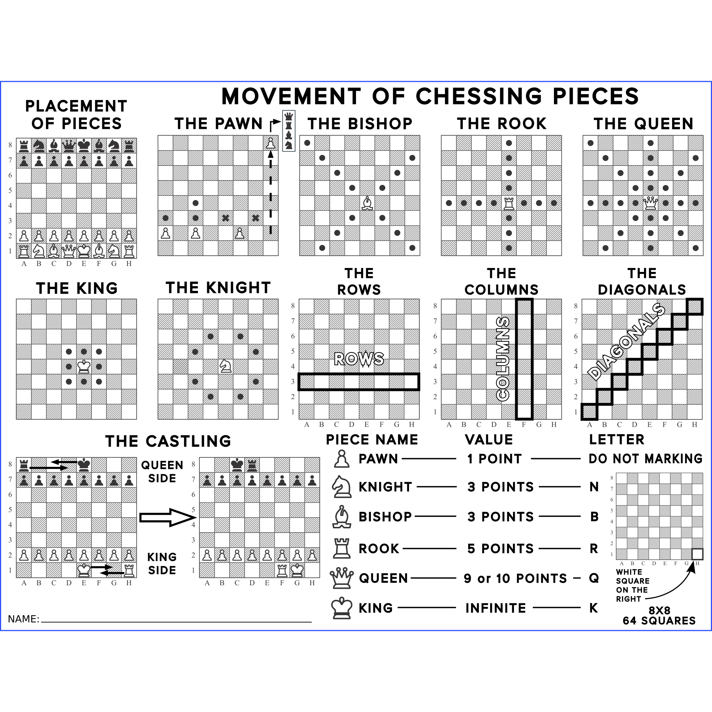
METHODOLOGY:

Slide 7
Requirement Analysis: Identify and understand the functional and non-functional requirements of the chess game, including gameplay rules, user interface, and AI capabilities.
Design: Design the class structure and data structures required for representing the chessboard, pieces, and game logic. Determine the algorithms for legal move generation, game state evaluation, and AI decision-making.
Implementation: Write the code in C++ to implement the chess game functionality, including move validation, player input handling, AI logic, and user interface components.
Testing: Conduct thorough testing to ensure the correctness and robustness of the implemented features. Perform unit testing, integration testing, and user testing to identify and resolve any issues or bugs.

Slide 8
Refinement and Optimization: Continuously improve the code and algorithms to enhance the game's performance, responsiveness, and user experience. Optimize critical sections to reduce computational complexity and improve AI decision-making speed.
Documentation: Create detailed documentation, including class diagrams, flowcharts, and user manuals, to provide clear instructions on the game's functionality and usage.
Iterative Development: Follow an iterative development approach, incorporating feedback from users and stakeholders to refine and enhance the game's features and performance.

Slide 9



TOOLS/TECHNOLOGY
VISUAL STUDIO CODE
VISUAL STUDIO
DEV C++

Slide 10
Visual studio code: Visual Studio Code (VS Code) is a lightweight, cross-platform source code editor developed by Microsoft. It provides a versatile and customizable environment for coding, debugging, and editing a wide range of programming languages. VS Code offers a rich set of features, including intelligent code completion, syntax highlighting, debugging support, version control integration, and extension support. It is designed to be highly customizable, allowing users to tailor the editor to their specific needs through themes, extensions, and settings. With its intuitive interface and extensive community support, Visual Studio Code has gained popularity among developers as a powerful and efficient coding tool.
Visual studio: Visual Studio is a comprehensive integrated development environment (IDE) developed by Microsoft. It provides a robust set of tools and services for building a wide variety of software applications, ranging from desktop applications to web and mobile applications, as well as cloud-based solutions.
Dev c++: Dev C++ is an integrated development environment (IDE) specifically designed for programming in the C and C++ languages. It provides a user-friendly interface and a set of tools to facilitate the development, compilation, and execution of C/C++ programs. Dev C++ offers features such as a code editor with syntax highlighting, code completion, and automatic indentation, making it easier to write and navigate through code. It includes a compiler that translates C/C++ source code into machine-readable code and an integrated debugger to assist with identifying and fixing errors during program execution.

Slide 11
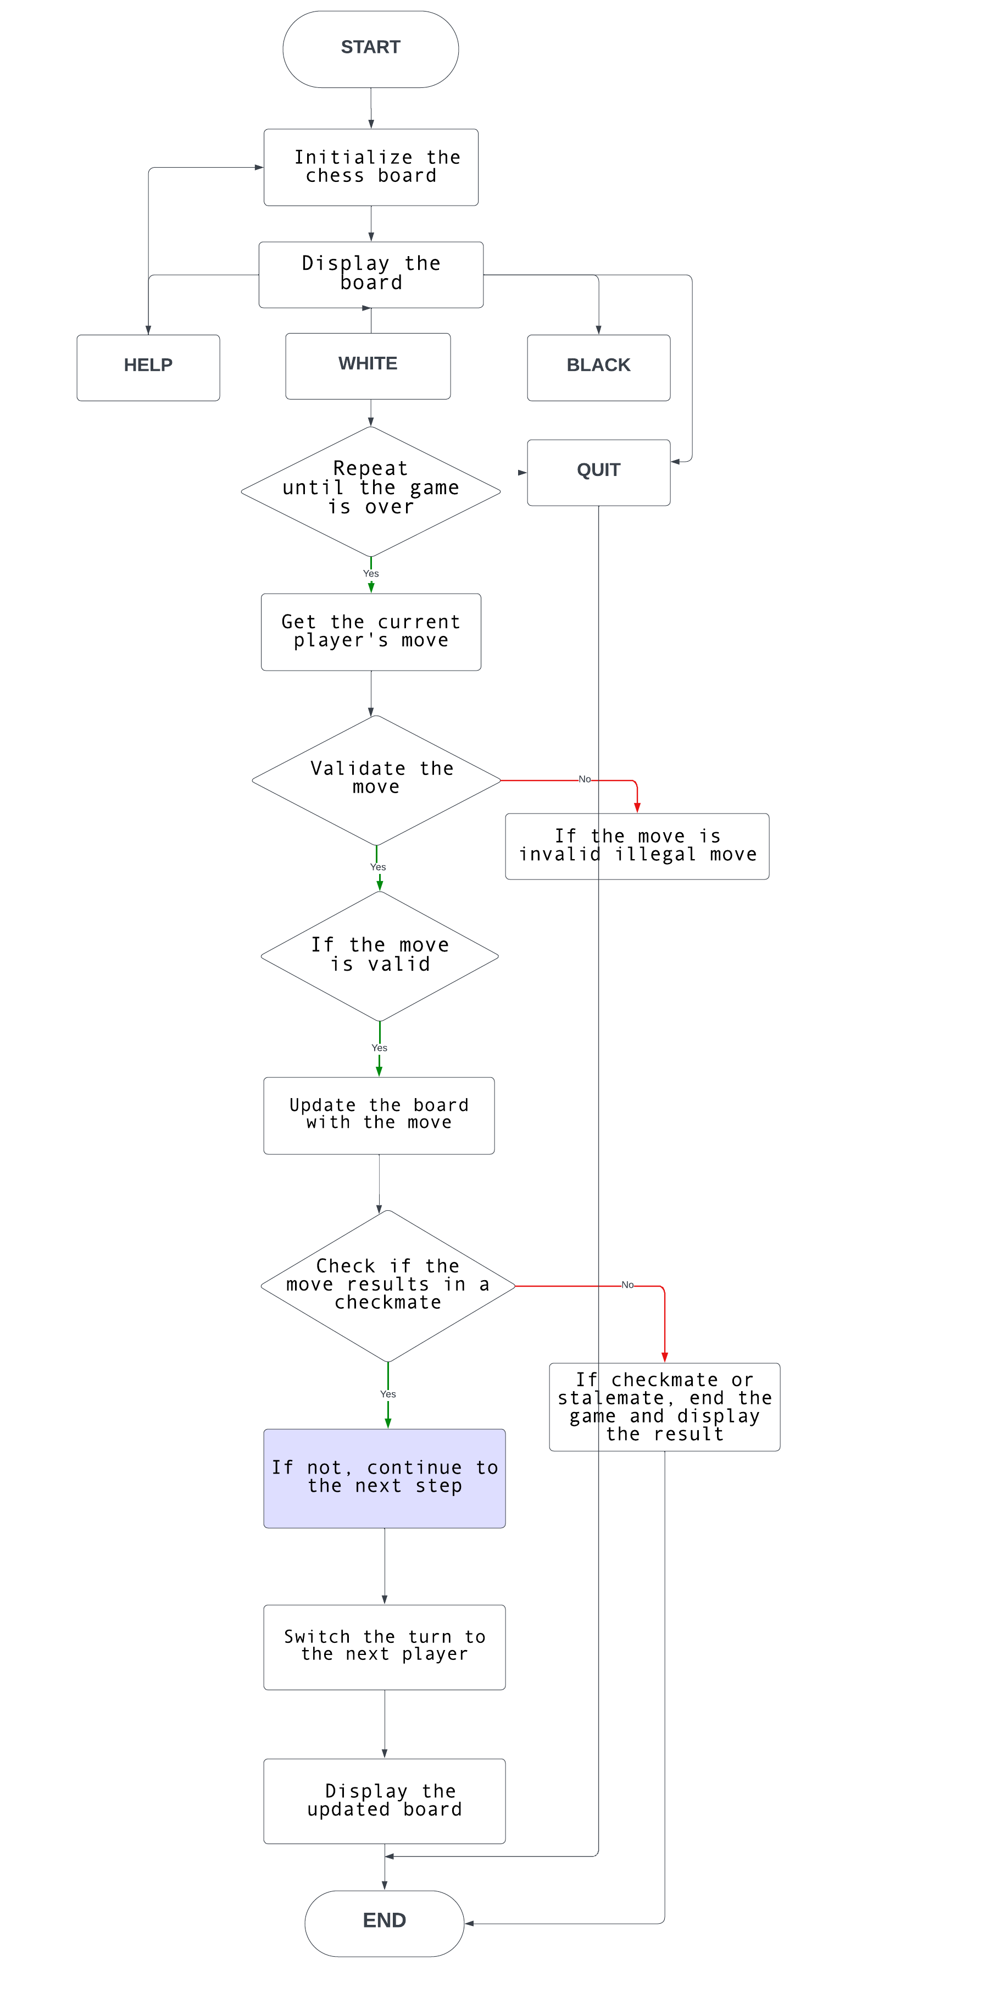
FLOWCHART:

Slide 12
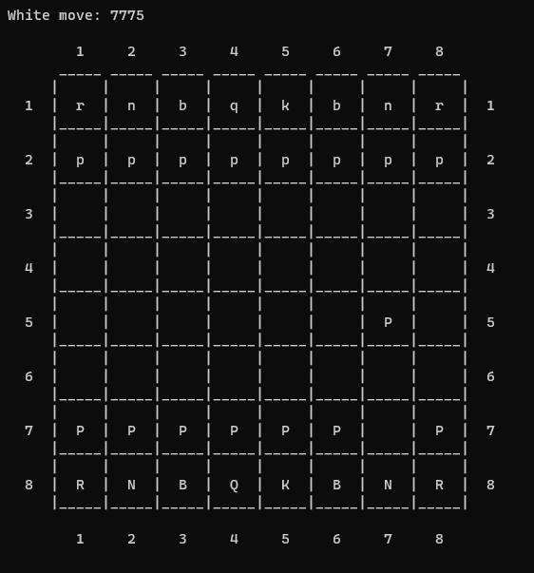
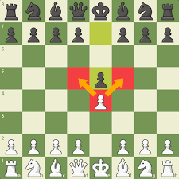
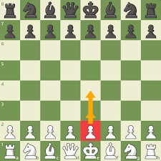
OUTPUT:
MOVEMENT OF PAWN:

Slide 13
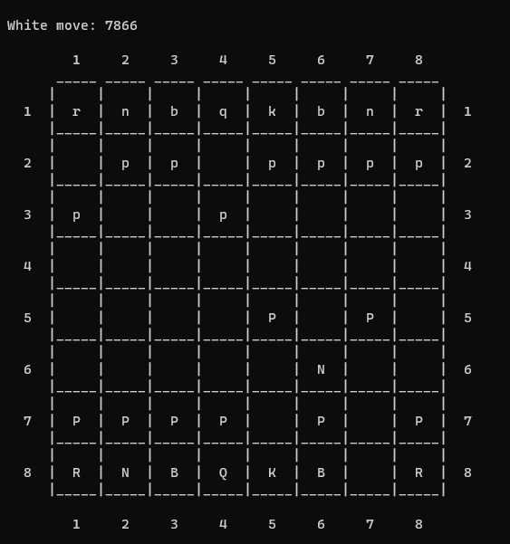
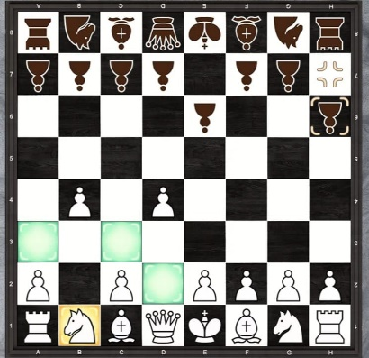
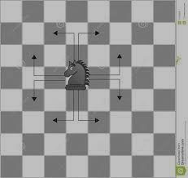
MOVEMENT OF KNIGHT:

Slide 14
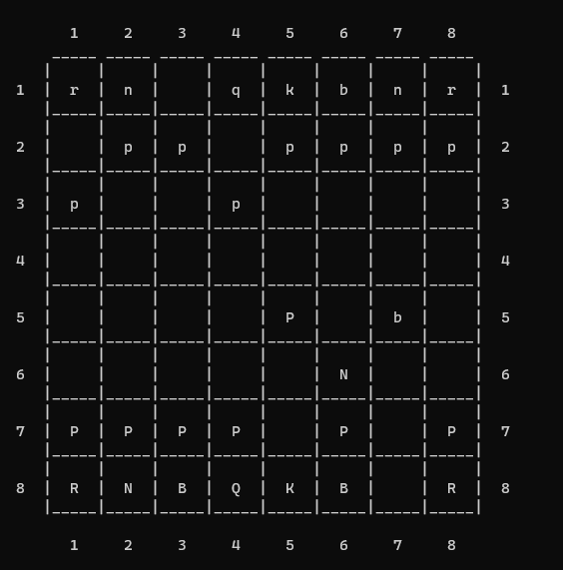
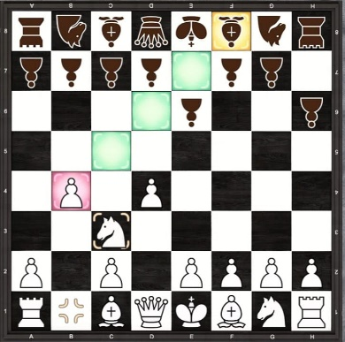
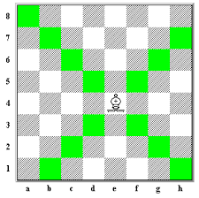
MOVEMENT OF BISHOP:

Slide 15
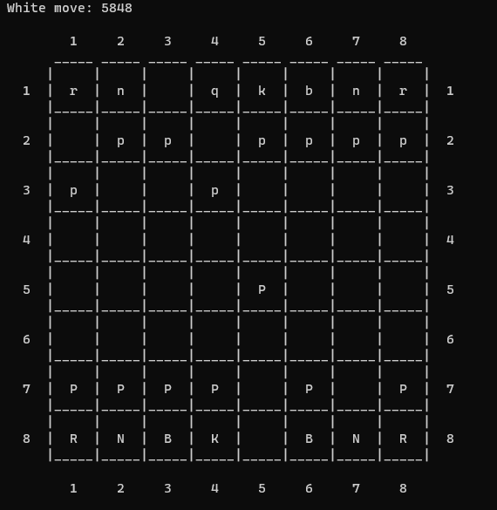
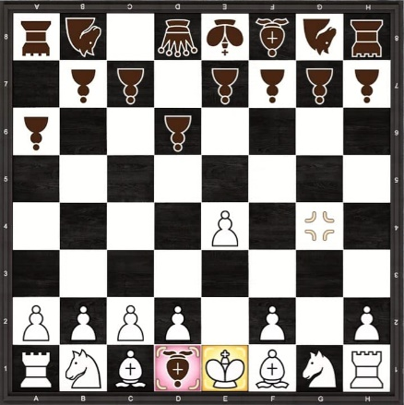
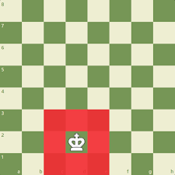
MOVEMENT OF KING:

Slide 16
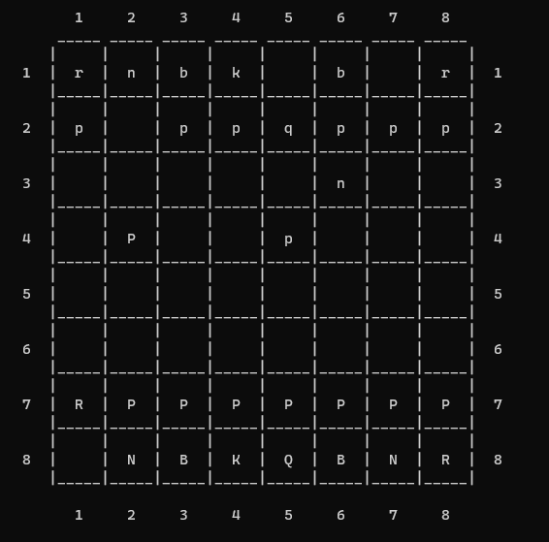
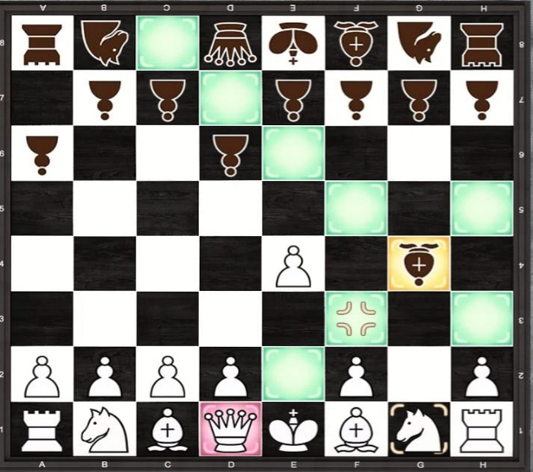
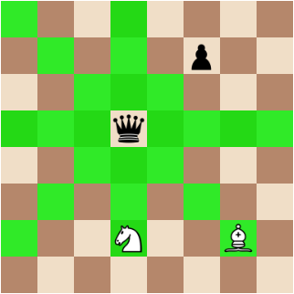
MOVEMENT OF QUEEN:

Slide 17
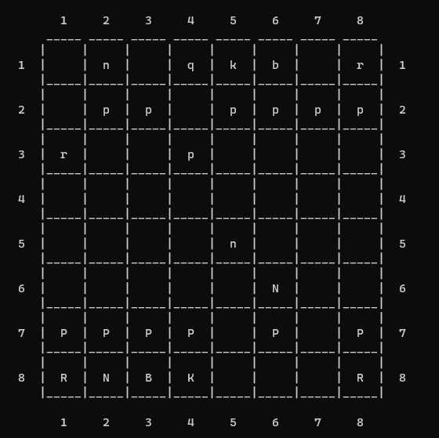
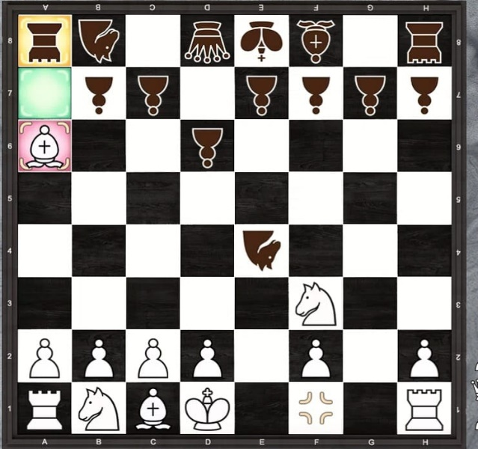
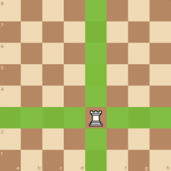
MOVEMENT OF ROOK:

Slide 18
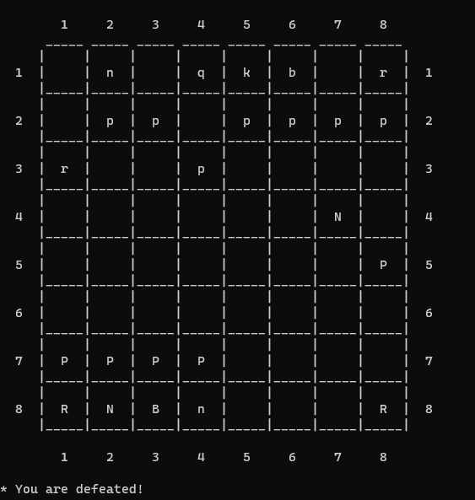
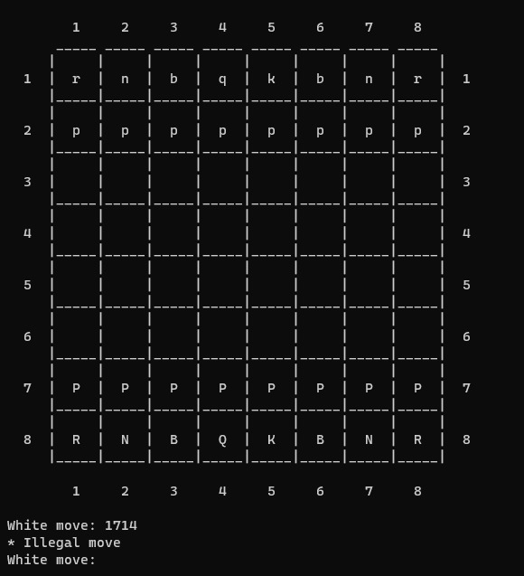
DEFEATED:
INVALID MOVE:

Slide 19
CONCLUSION :
In conclusion, the Chess Game project in Data Structures and Algorithms (DSA) using C++ has been successfully developed, demonstrating the application of DSA concepts in creating a functional and interactive chess game. The project aimed to implement a chess game with human versus AI gameplay, providing an engaging and challenging experience for players. Through the project, several objectives were achieved, including designing an efficient data structure for representing the chessboard and pieces, implementing move validation logic, incorporating AI decision-making using algorithms like minimax or alpha-beta pruning, and creating a user-friendly interface for intuitive gameplay. The project also emphasized the importance of testing and refinement to ensure the correctness and robustness of the implemented features. Overall, this project has not only enhanced the understanding and application of DSA concepts but also provided an opportunity to explore the complexities involved in designing and developing a complete chess game.

Slide 20
REFERENCE:
https://lucid.app/lucidchart/07f5b57c-1363-4137-85f9-7fd98a39a592/edit
https://iopscience.iop.org/article/10.1088/1742-6596/1195/1/012013/pdf

Slide 21
THANK YOU

